Slide 1
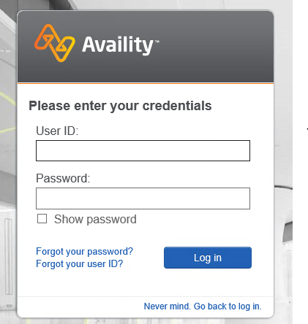
EOB from Availity Portal
First log in to portal, We see the below page:-

Slide 2
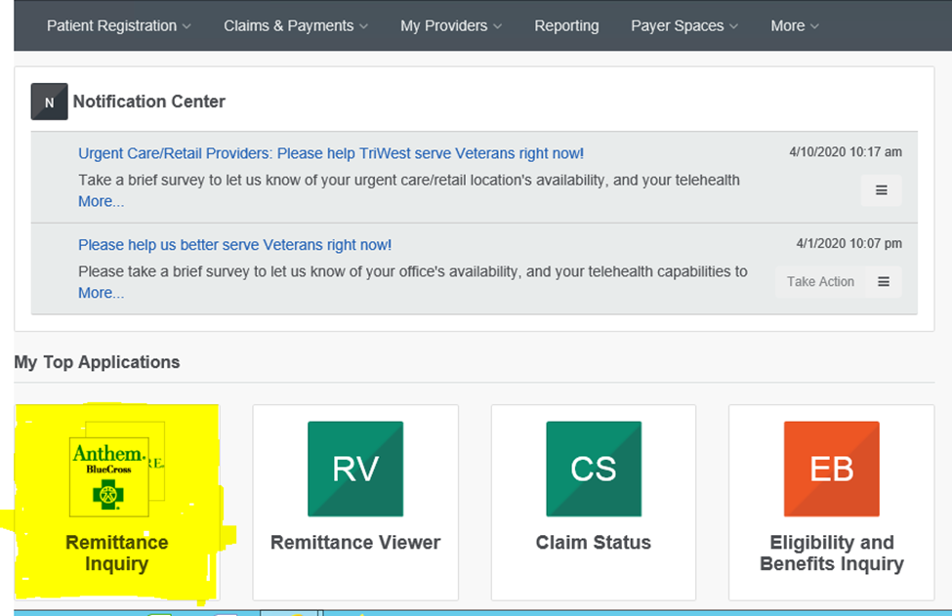
Enter the User and Password to login In
After login in we see the below page:-

Slide 3
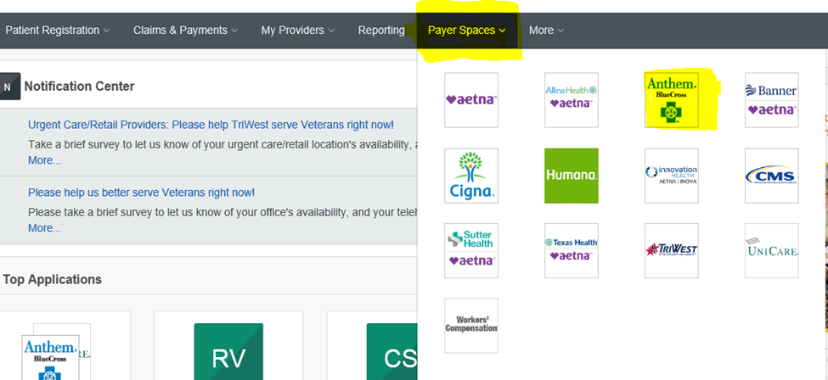
Or Click On Payer Space from the TOP:-

Slide 4
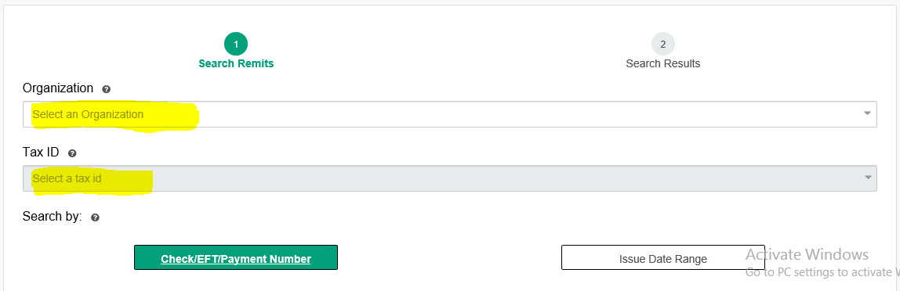
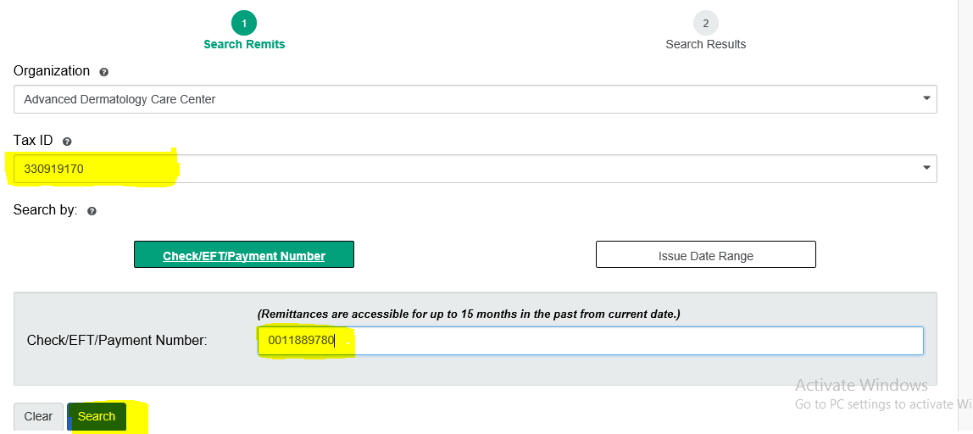
Now below page opens, select the Organization and TAX ID:-
For Example we need to pull the EOB for Ck#0011889780, For Provider Kamali, Then we will select the TAX ID of Kamali Medical Grp:-

Slide 5
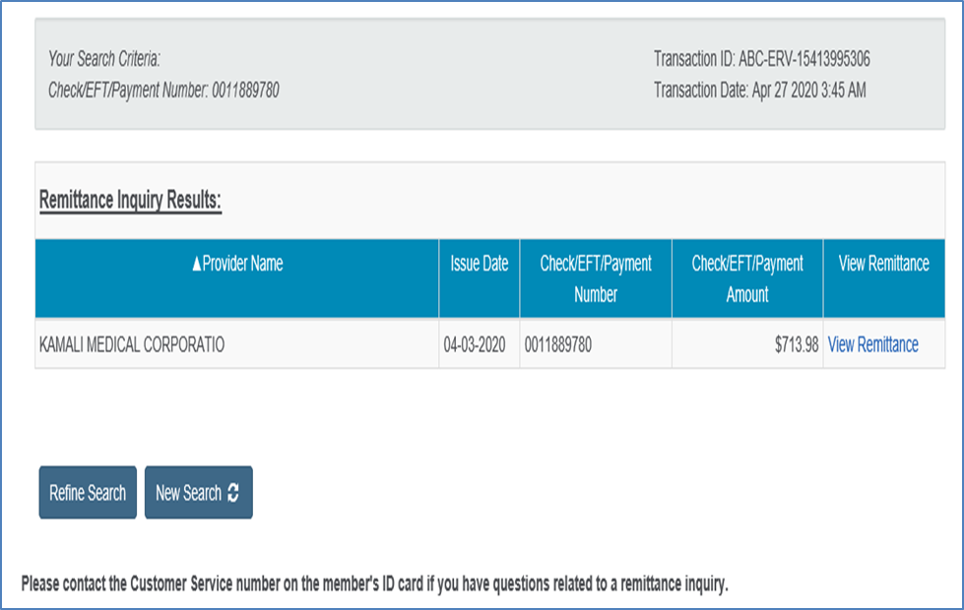
We will see the below page:-

Slide 6
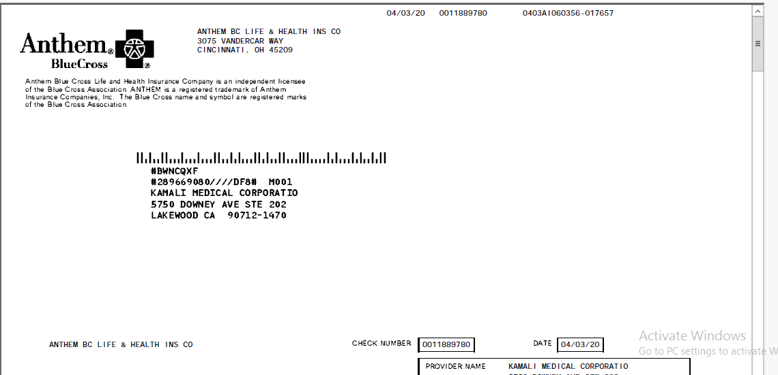
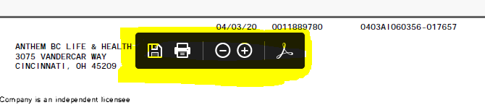
Then Click on remittance View, The we see the complete EOB and save it :-

Slide 7
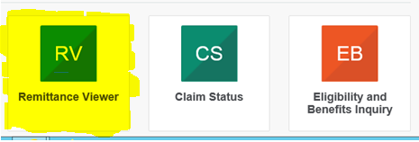
This is the whole procedure to pull the Blue Cross EOB from Availity Portal.
We can also pull the below insurance by Clicking on Remittance Viewer:-
• Health Net for some providers
• Regence
• Aetna
We need to select the date range to pull these EOB’s.
Thank You

